Slide 1
STUDENT PERFORMANCE ANALYSIS SYSTEM

Slide 2
STUDENT PERFORMANCE ANALYSIS SYSTEM
Submitted by,
A.Yuvaraj
II M.C.A ,
20214012404160,
Department of CSE,
Manonmaniam Sundaranar University,
Tirunelveli.
under the guidance of,
Dr.R.S.Rajesh.,M.E.,Ph.D.,
Professor,
Department of CSE,
Manonmaniam Sundaranar University,
Tirunelveli.

Slide 3
Content
S. No | Title | Slide No
1 | Objective | 4
2 | System Analysis | 5
3 | Novelty | 7
4 | System Requirement | 8
5 | System Design | 9
6 | Sample Output

Slide 4
1.Objective:
The Main objective is to developed a platform for student and faculty member to effectively manage the activities of attendance maintenance , Assignments , seminar etc.
Reduce the paper work and saving time to generate accurate results from student’s performance.
It is also proposed to apply a basic Machine Learning concepts to predict overall performance of the student.

Slide 5
2.System Analysis :
2.1 Existing System :
In existing system there are various problem like .
Collect all the document manually.
Time consuming for this process is very high.
Maintaining all hard copies of record is difficult.

Slide 6
2.2 Proposed System :
Database
User name, Password
Admin
Faculty
Student
Faculty Subject Allotment
Manage Faculty details
3. Manage Student details
View all Status report
Send Announcement
Internal assessment entry
Performance Remarks & Status
Send Announcement
View their seminar / assignment marks
View their internal marks
View performance status
Get notifications

Slide 7
3.Novelty of the Project :
Graphical representation
Emoji prompt service
Predict the overall performance of student

Slide 8
4.System Requirement :
4.1 Hardware Requirement :
Processer : Intel i7
RAM : 8 GB
4.2 Software Requirement :
OS : Windows 10
Front End : Html, css, Javascript
Back End : php, MySQL

Slide 9
5. System Design :
Data Flow Diagram:
Faculty details
(add/update/ delete)
Student details
(add/update/delete)
Admin
Status report
Send Announcement

Slide 10
Internal
assessment entry
Faculty
Performance Remark & status
Send Announcement

Slide 11
Mobile App Development:
View their seminar marks
View their assignment marks
Student
Login Page
View performance status
Get notifications from Admin / Faculty

Slide 12
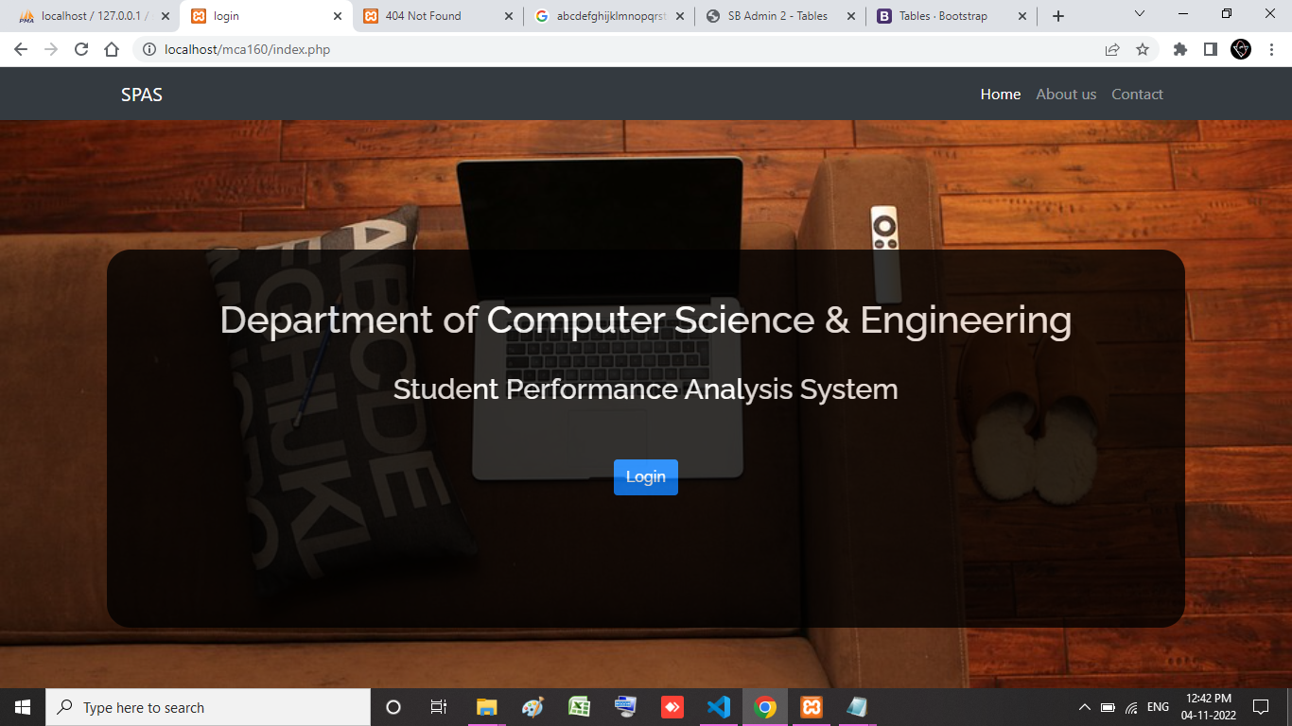
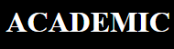
6.Sample Output :
Login page:

Slide 13
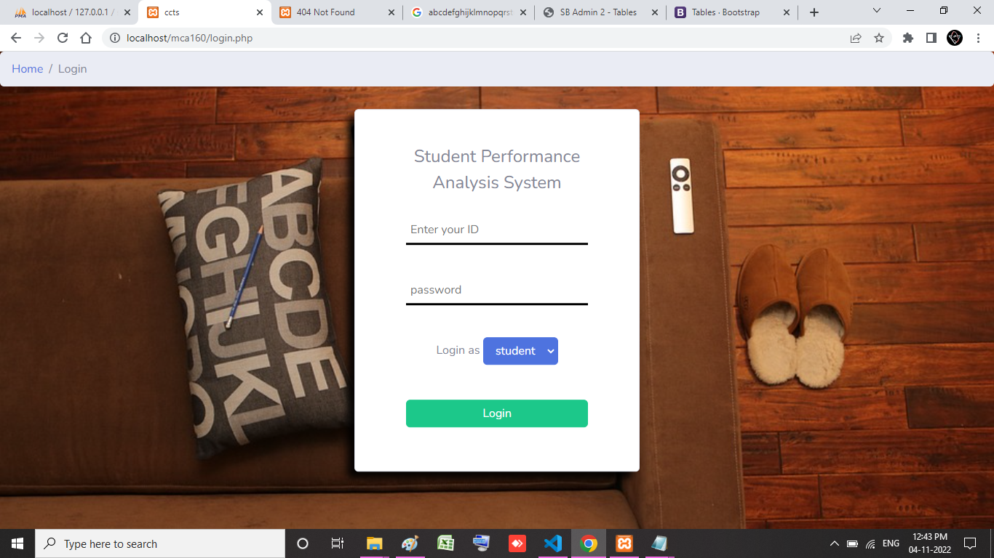
If the field is empty, it show some alert message

Slide 14
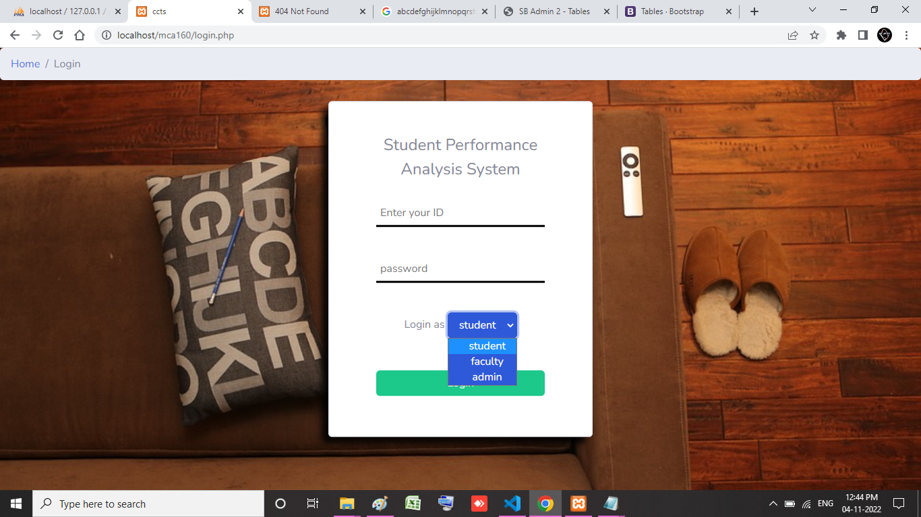
If the field is empty, it show alert message

Slide 15
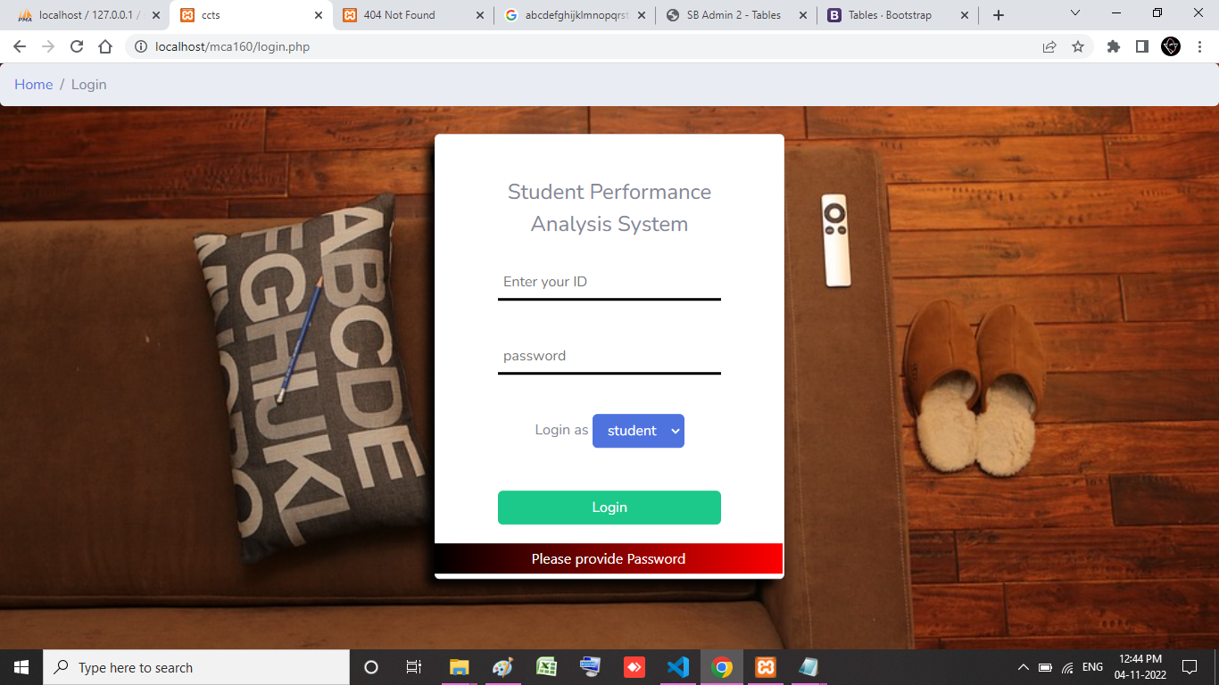
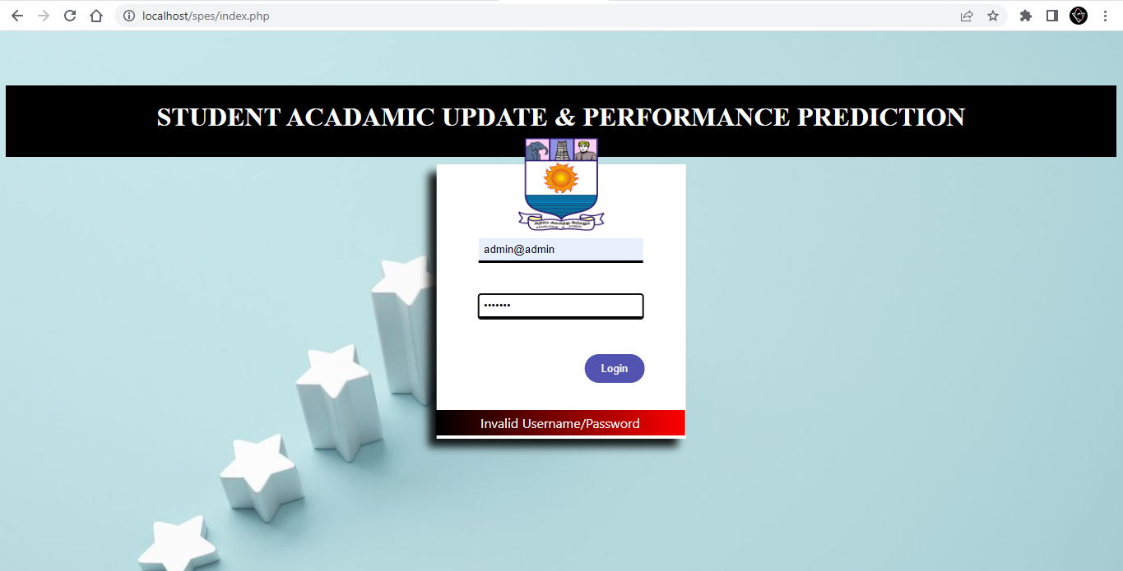
If the username / password is invalid, it show alert message

Slide 16
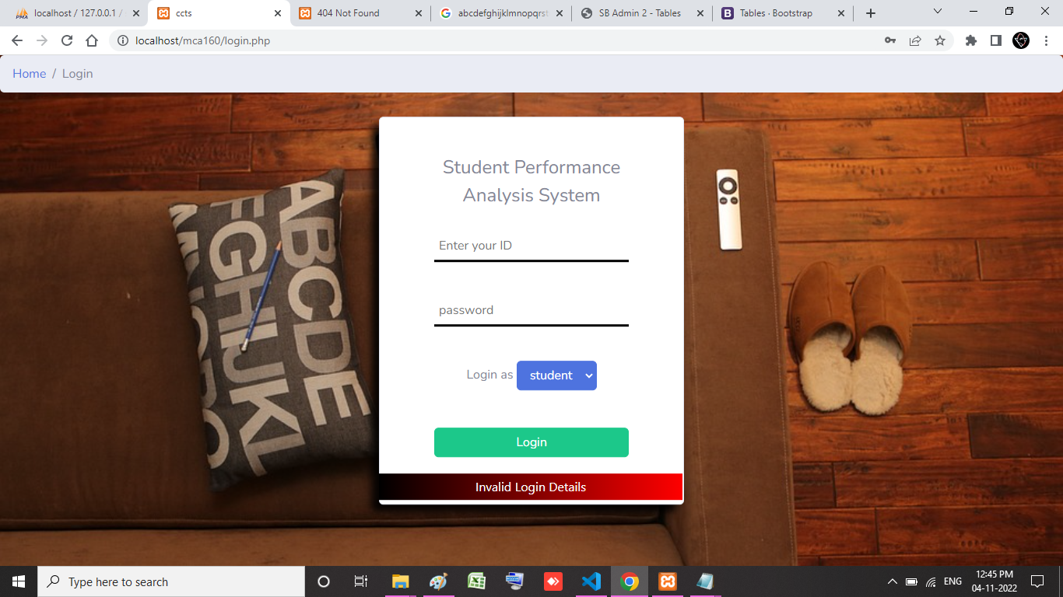
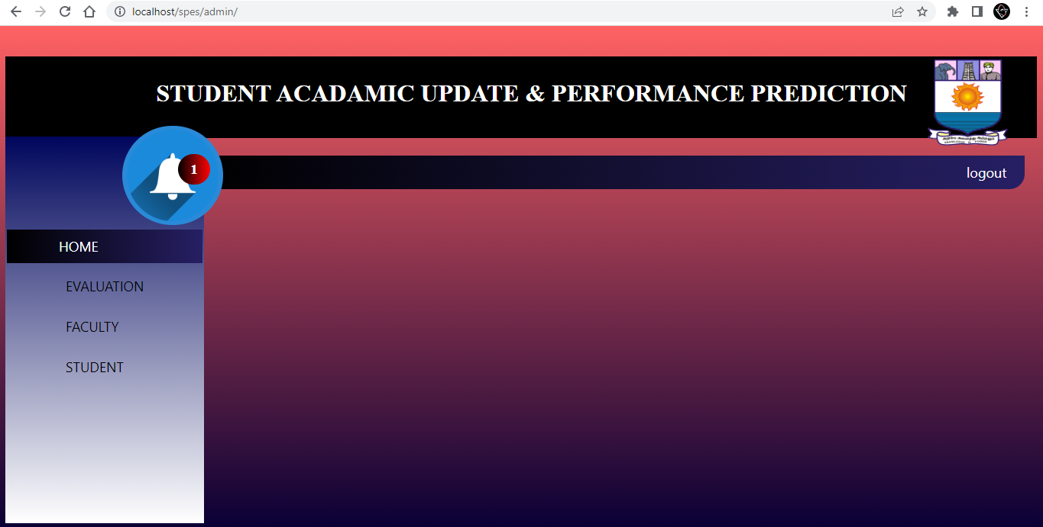
Admin Panel:

Slide 17
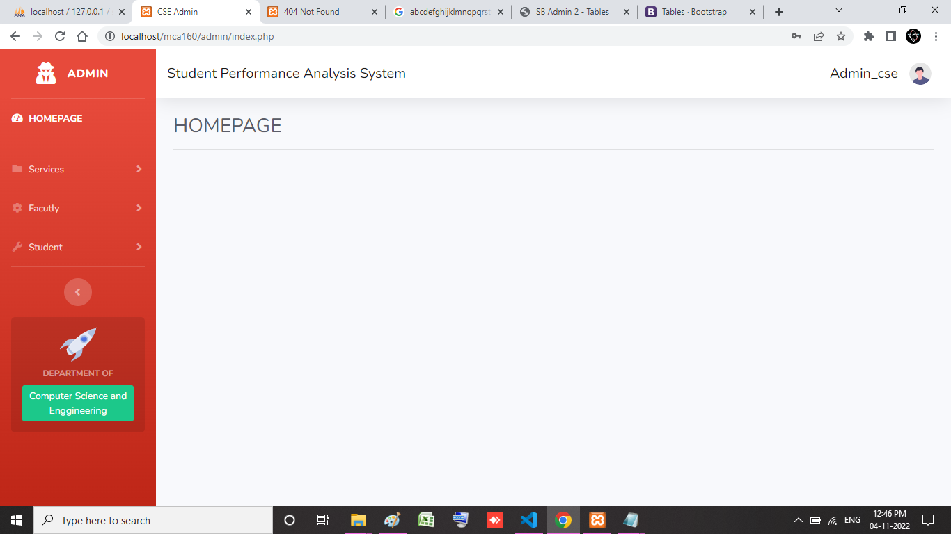
Announcement:

Slide 18
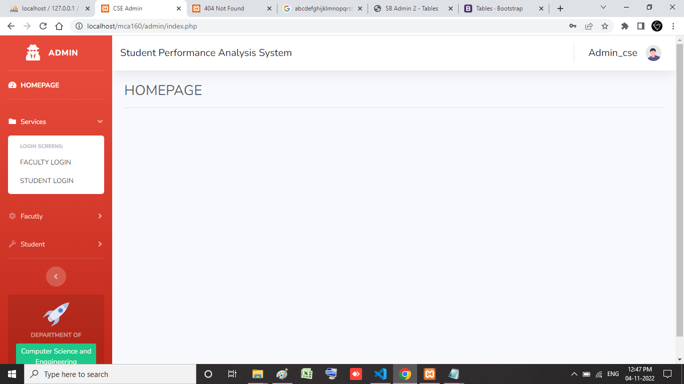
Add Announcement:

Slide 19
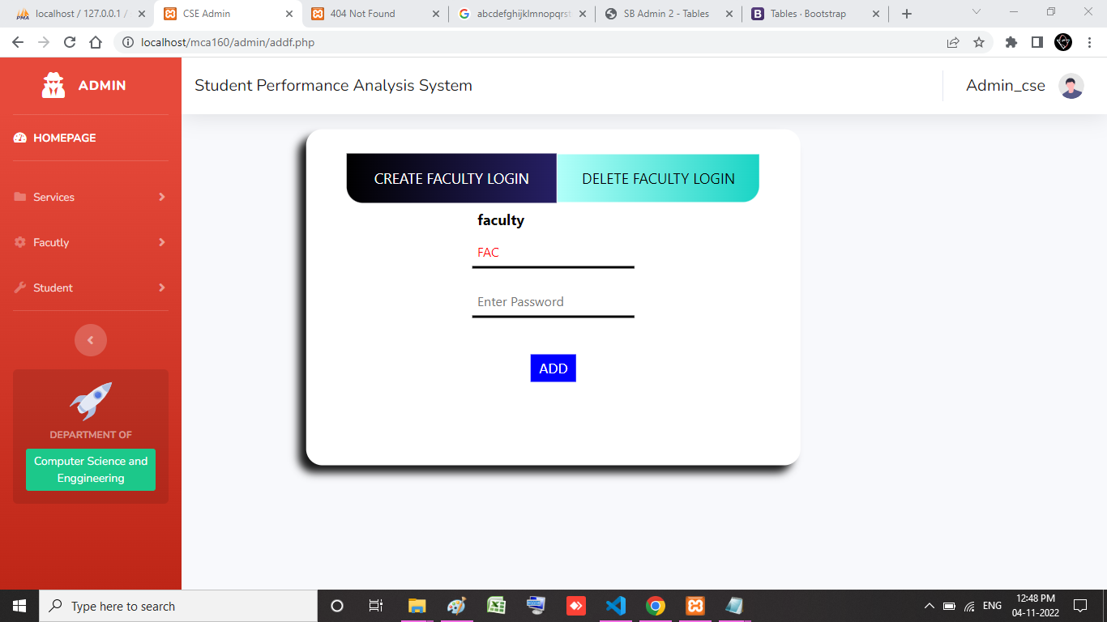
View Announcement:

Slide 20
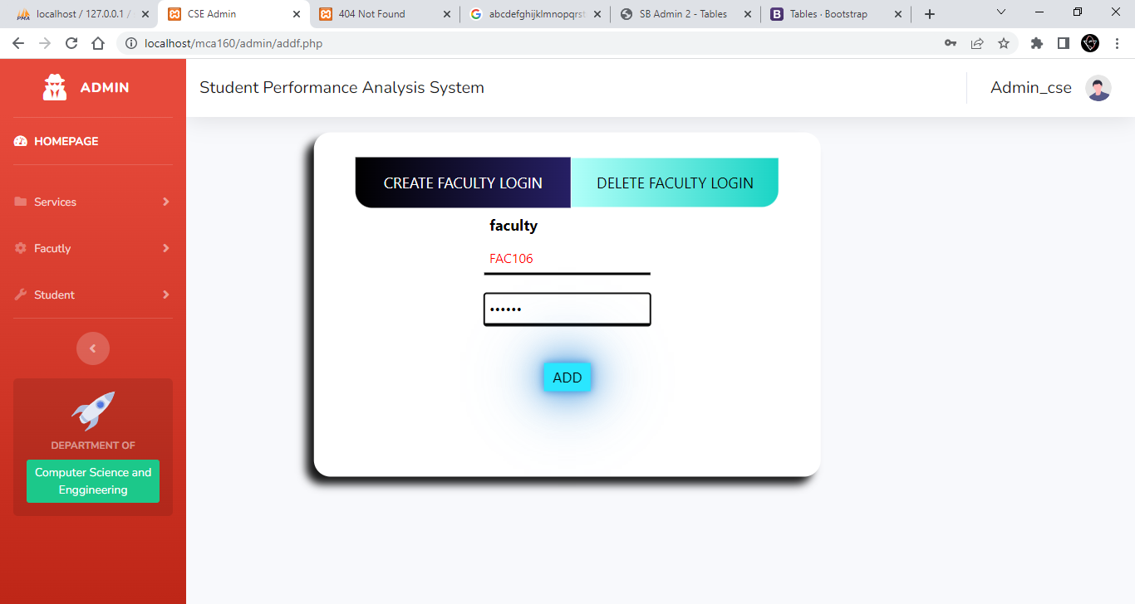
Print Announcement:

Slide 21
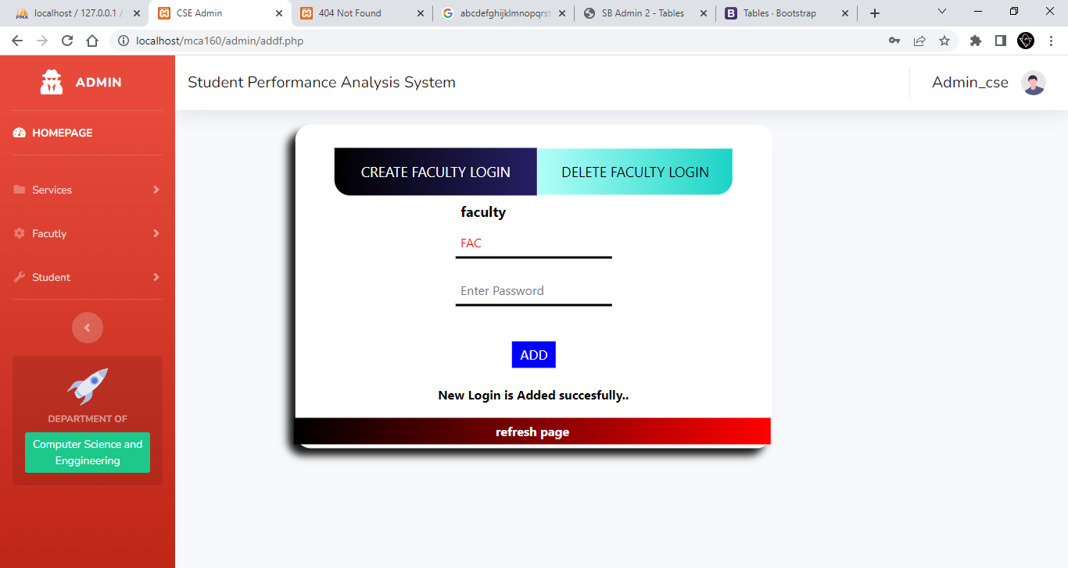

Slide 22
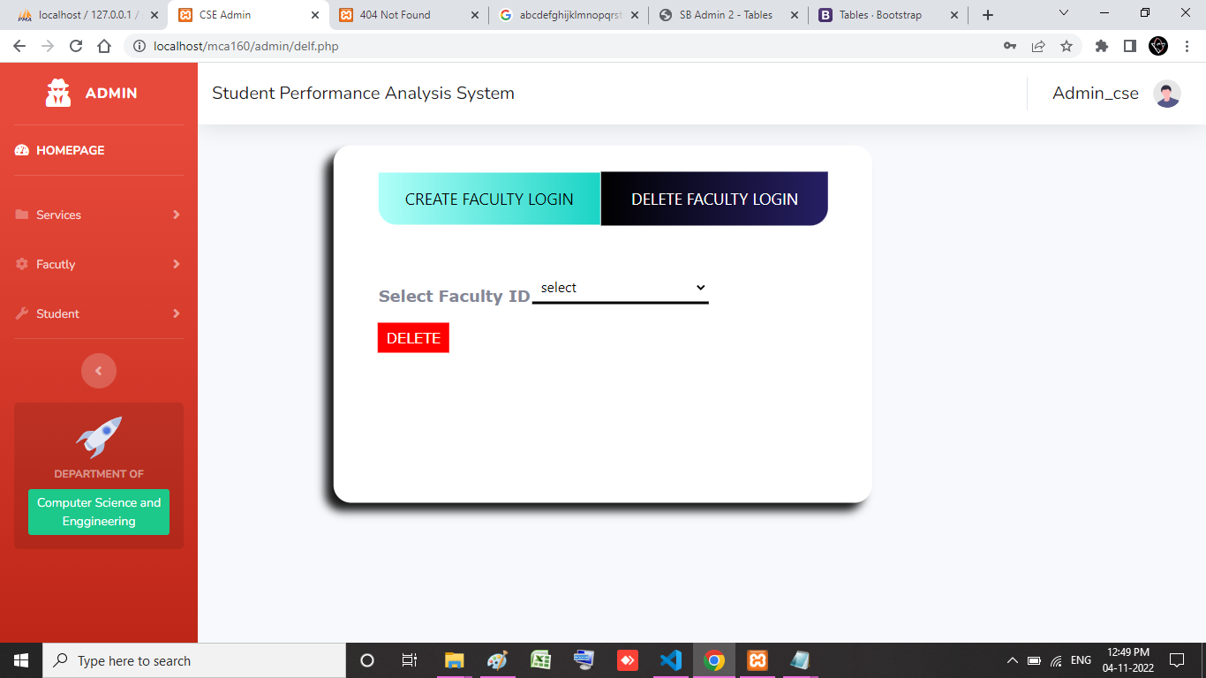

Slide 23
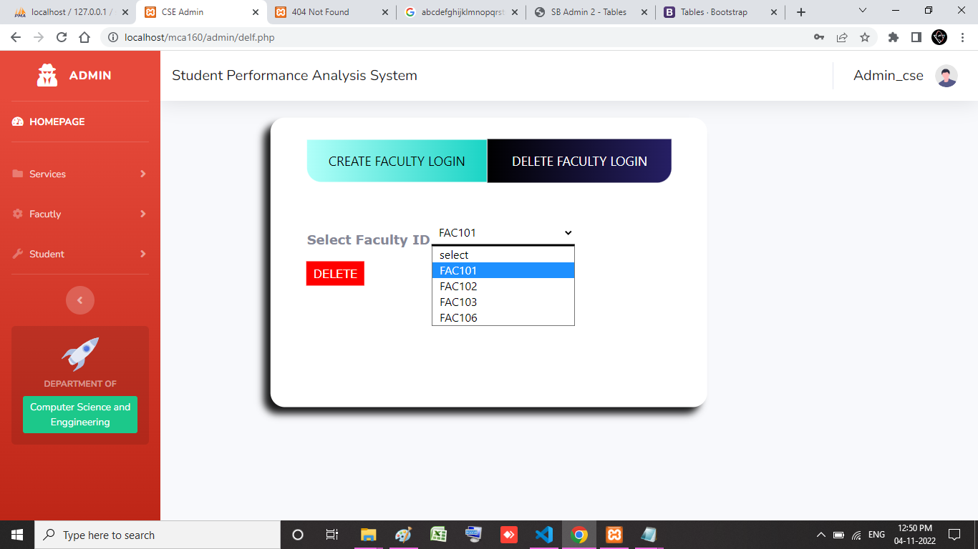

Slide 24
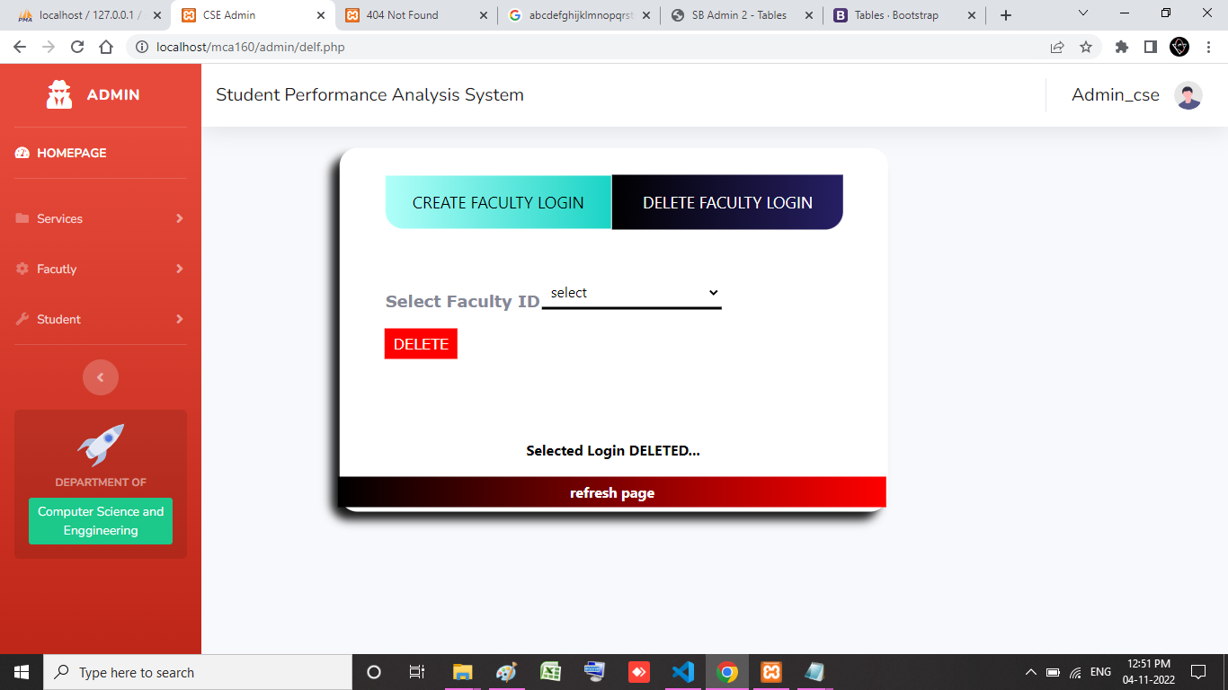

Slide 25
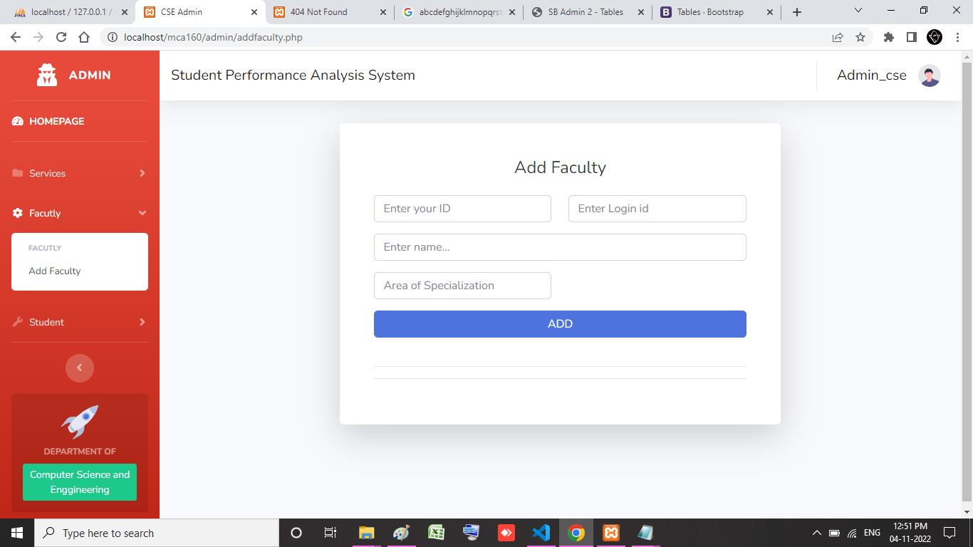

Slide 26
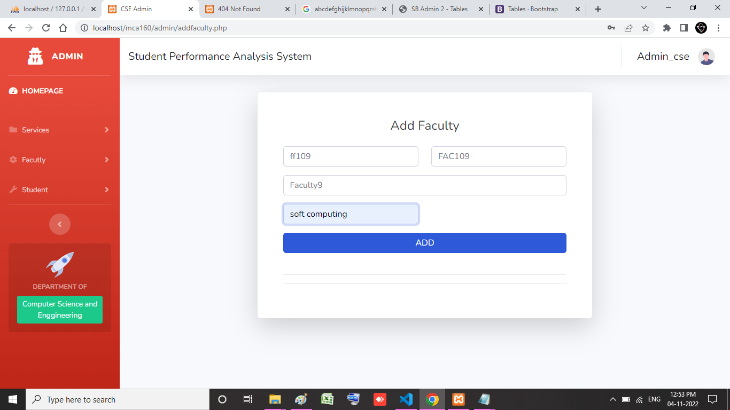

Slide 27
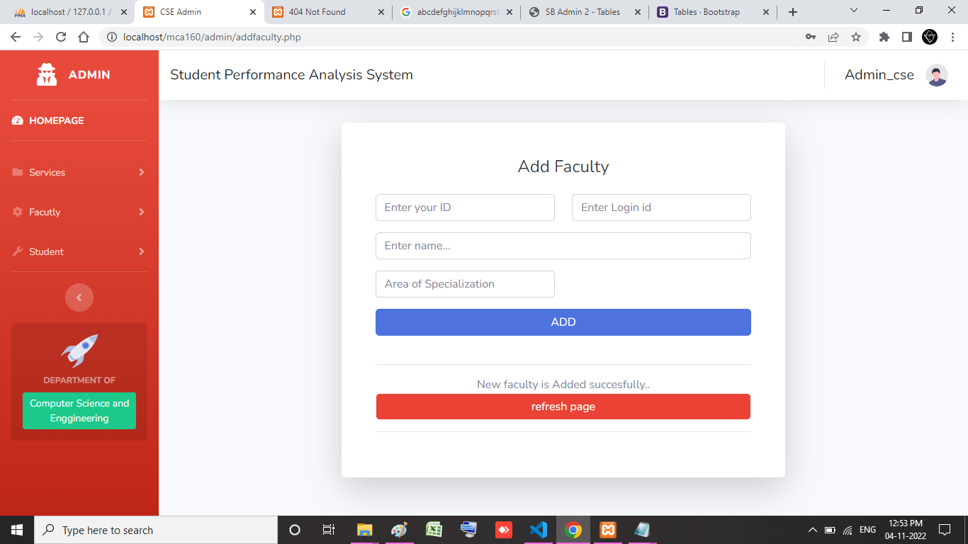

Slide 28
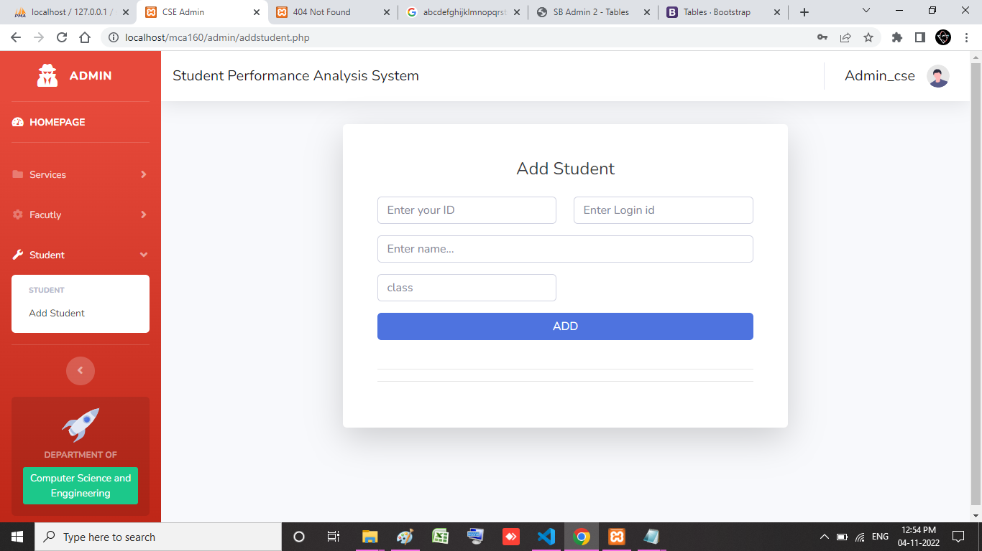

Slide 29
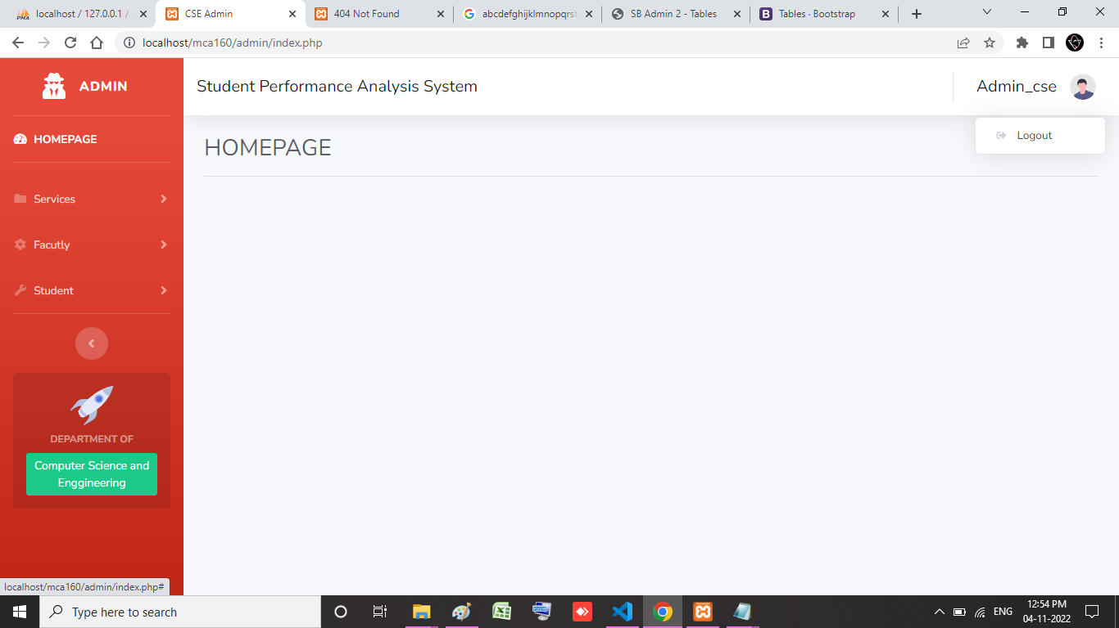

Slide 30
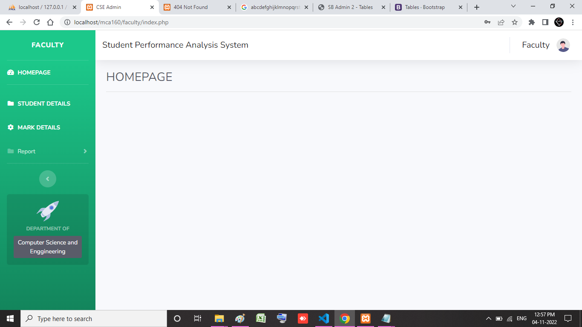

Slide 31
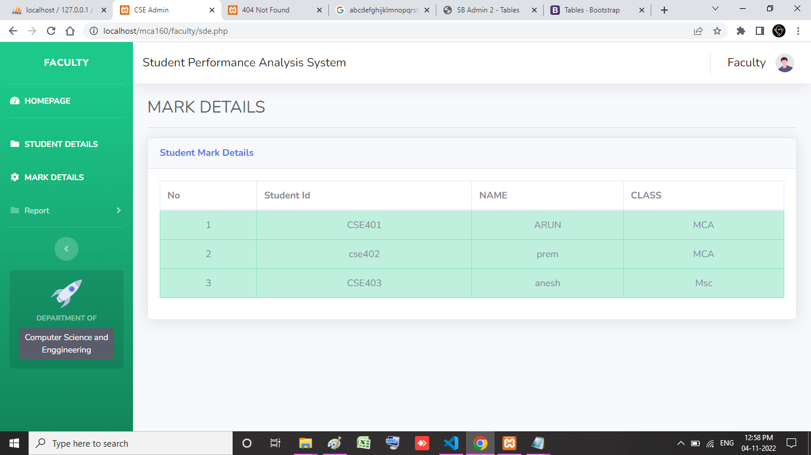

Slide 32
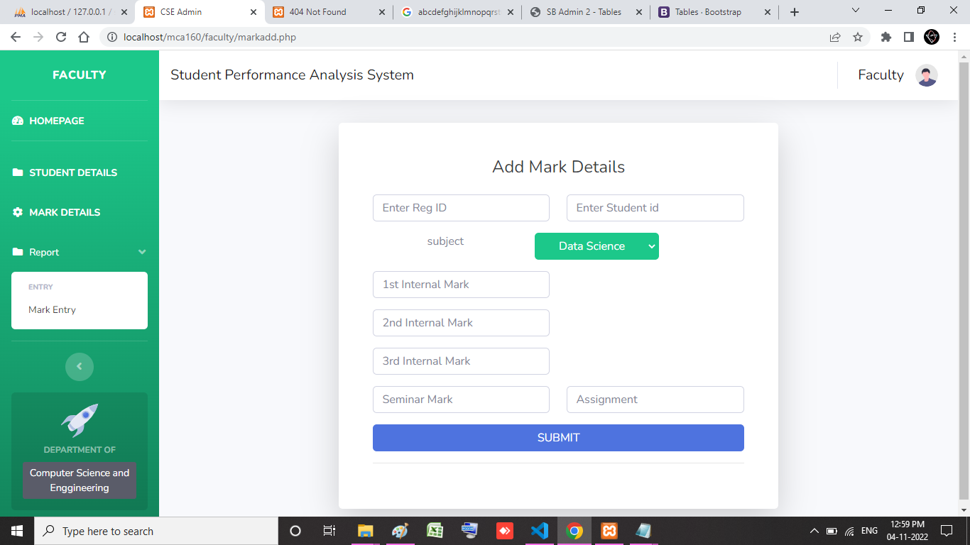

Slide 33
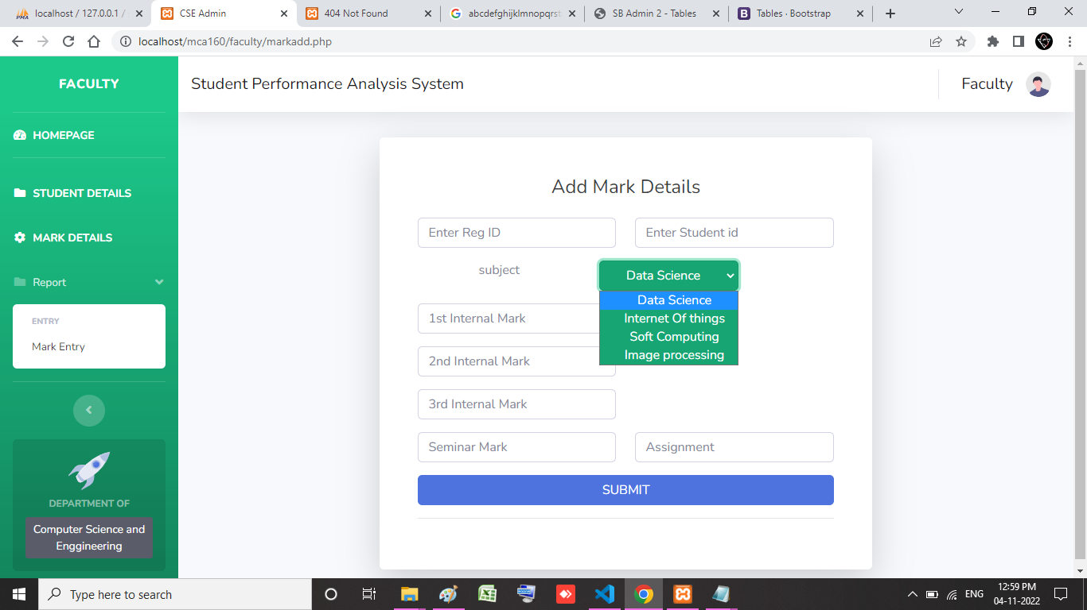

Slide 34
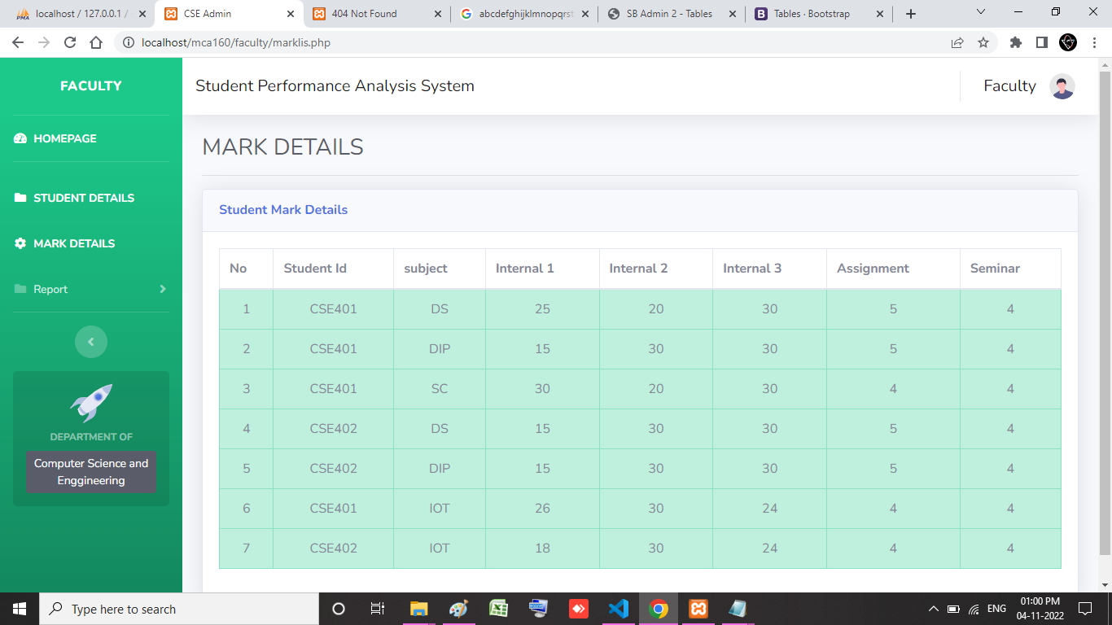

Slide 35


Slide 36
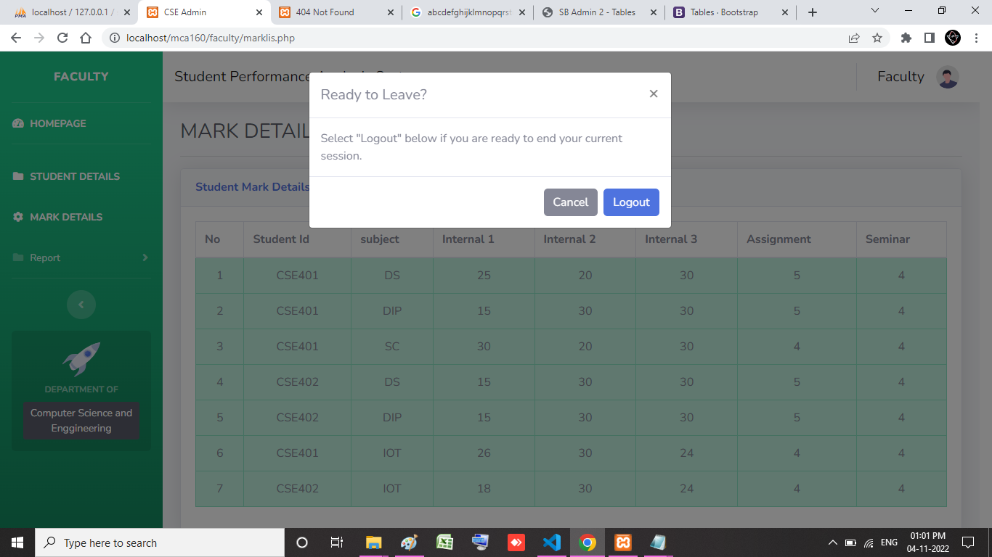

Slide 37
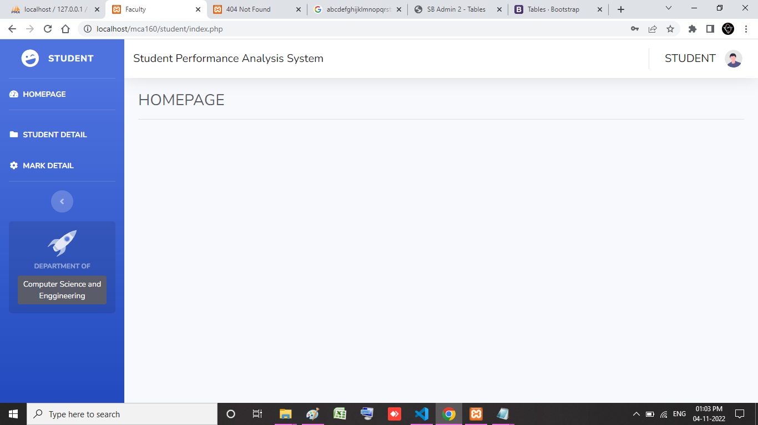

Slide 38
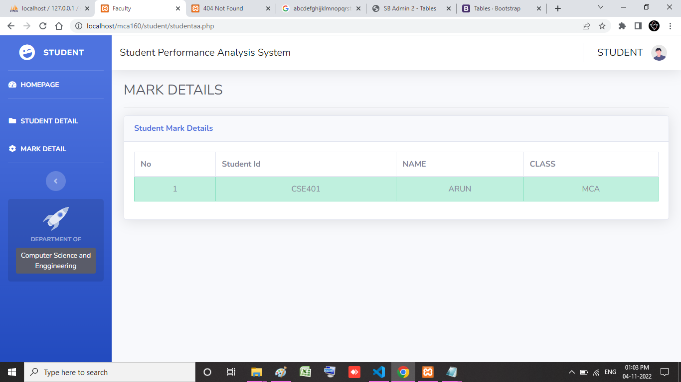

Slide 39
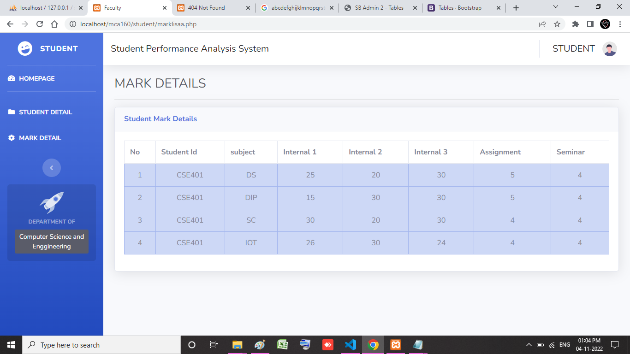

Slide 40
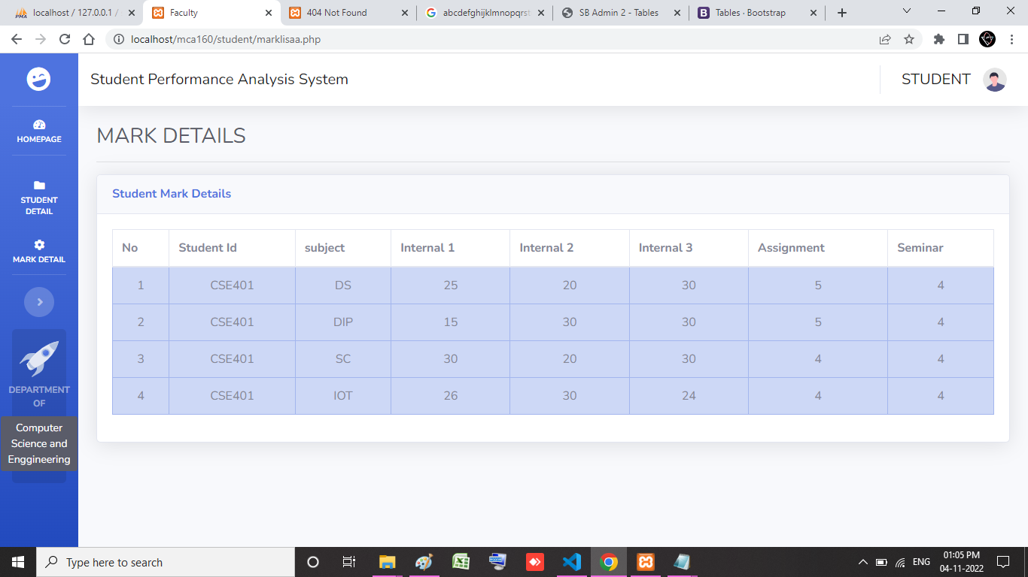

Slide 42
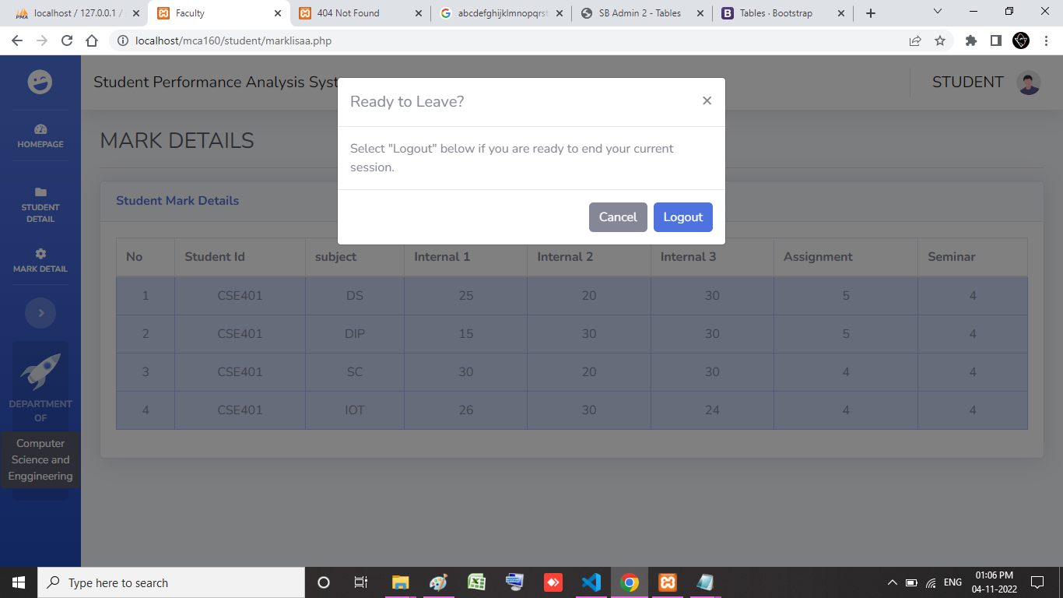

Slide 43

Thank you

